Slide 1
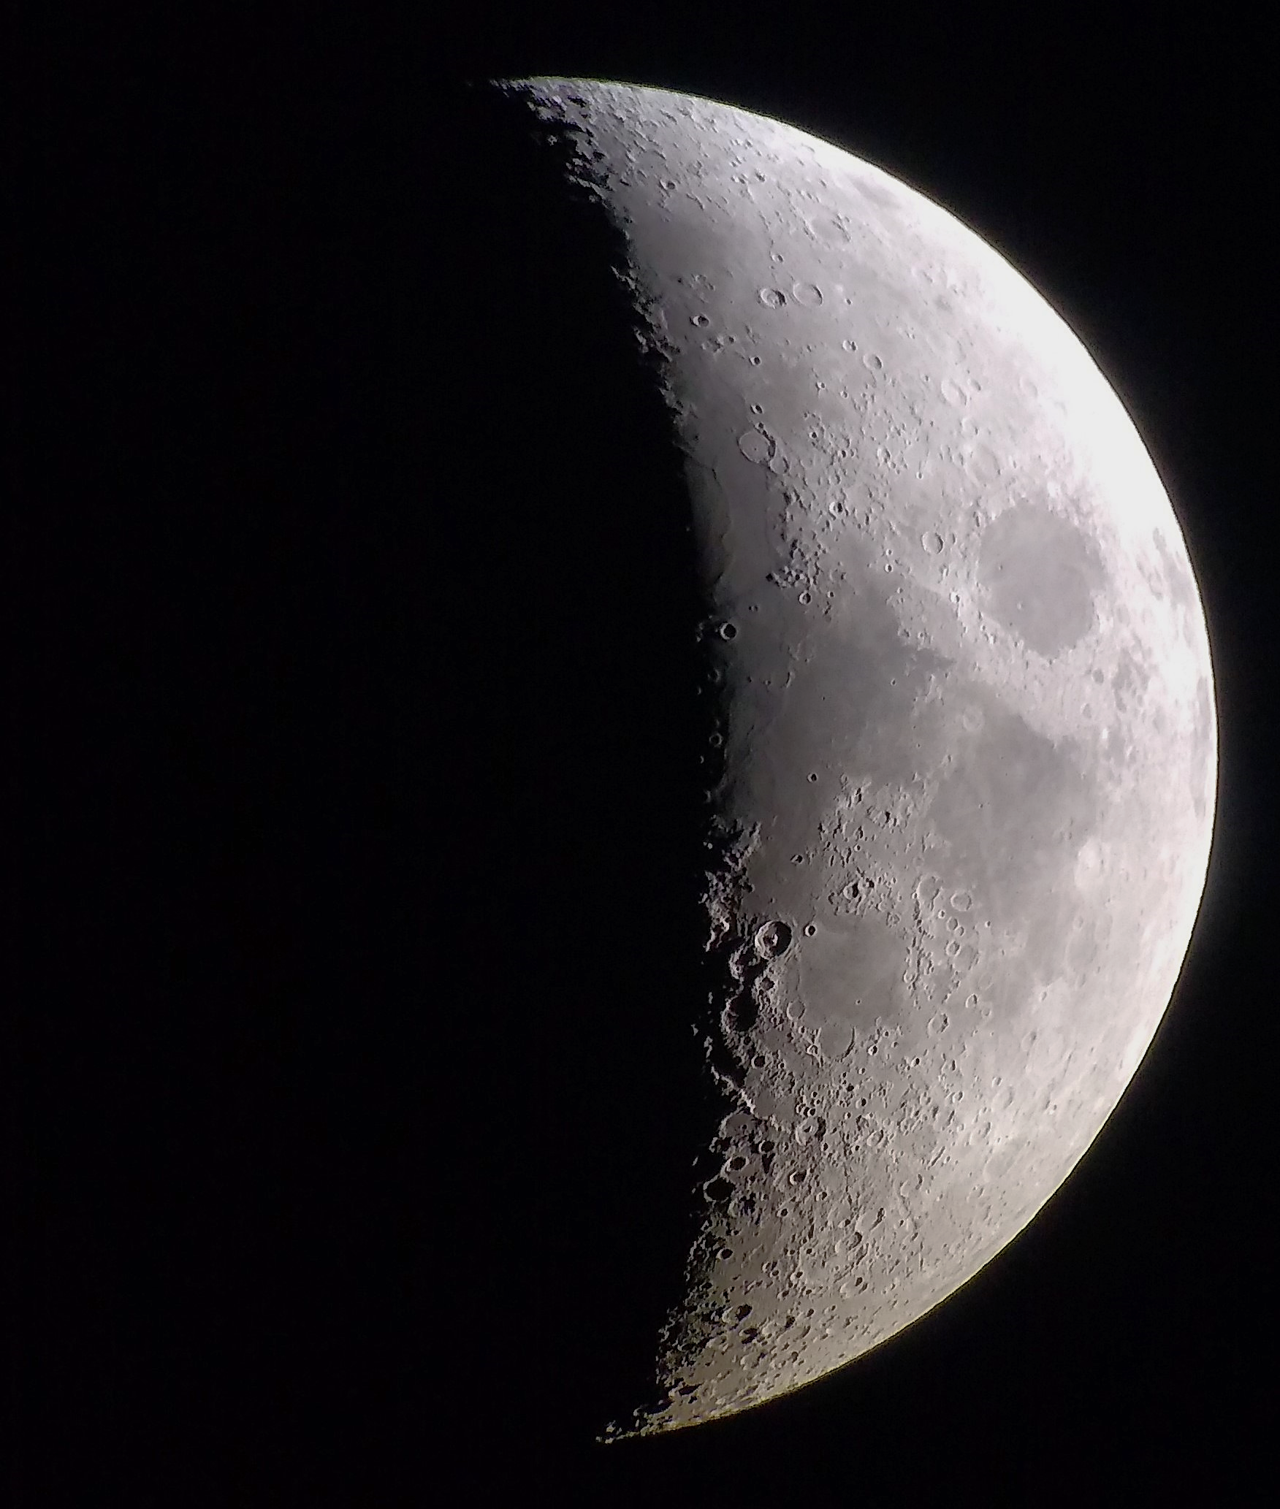
Lunar Meteoroid Ejecta Engineering Model
2/17/2022
Anthony M. DeStefano
NASA/MSFC/EV44 Natural Environments

Slide 2
LMEEM Assumptions
The Moon is approximated as a smooth sphere with a monopolar gravitational field
Equations derived from Kepler’s laws and spherical trigonometry can be used
Surface roughness is ignored (conservative)
The Meteoroid Engineering Model (MEM) correctly defines the sporadic meteors of masses between 1ug and 10g at the Moon
The mass distribution follows Grun 1985
Time scale of input environment is a Metonic cycle (19 years), averaging over many Sun-Earth-Moon geometries, similar to a Saros cycle
The near-Earth object component of the primary fluxes can be approximated by the MEM-LO population (per NESC rec.) for the angular distribution, using CNEOS data for the speed distribution for masses greater than 10g (up to a size of 0.1% chance of impact in 19 years)
The mass distribution follows Memo OSMA/MEO/Lunar-001, 2020, based on Brown et al. 2002
Density of NEOs are 3 g/cc
The meteoroid ejecta from an impact mapped to a spherical volume element (wedge) that inscribes a cylinder (asset) is a good estimation for ejecta impacting a cylindrical asset directly (conservative)
The extreme corners of the wedge provide a bound of all impact points onto the wedge
The asset can be at any location on the lunar surface or above the lunar surface (i.e., in orbit)

Slide 3
LMEEM Assumptions, cont’d
The mass ejected by an impact follows scaling laws provided in Housen & Holsapple 2011
Impacts from MEM populations use a target with sand/fly ash properties and NEO impacts use a target with basalt properties (latter, per NESC rec.)
Regolith assumed to have a tensile strength of 3.3E6 Pa (an average value of simulated regolith given in Yanou et al. 2014)
Regolith particle density is 3.1 g/cc and porosity is 0.4 (DSNE)
Crater ejecta have a maximum velocity as defined by Housen & Holsapple 2011
The minimum ejecta velocity is the minimum velocity required to lift ejecta to the rim of the crater from the bottom (O’Keefe & Ahrens 1985)
The largest ejecta particle mass is 1/100 of the total ejected mass (Koschny & Grun 2001, conservatively small), alternatively, see O’Keefe & Ahrens 1985 for a higher upper bound
The meteoroid ejecta particle size distribution follows a power-law (e.g., O’Keefe & Ahrens 1985, Koschny & Grun 2001, Buhl et al. 2014)
Specifically, for each ejecta speed, a power-law form is given for the particle size that is scaled by a mass-fragmentation factor → larger particles are slower while smaller particles are faster (O’Keefe & Ahrens 1985)
The angular distribution of ejecta is peaked following Gault & Wedekind 1978 for oblique impacts, using a beta distribution
The azimuth distribution is a modified version of Rival & Mandeville 1999, giving more ejecta in the downstream direction for oblique impacts

Slide 4
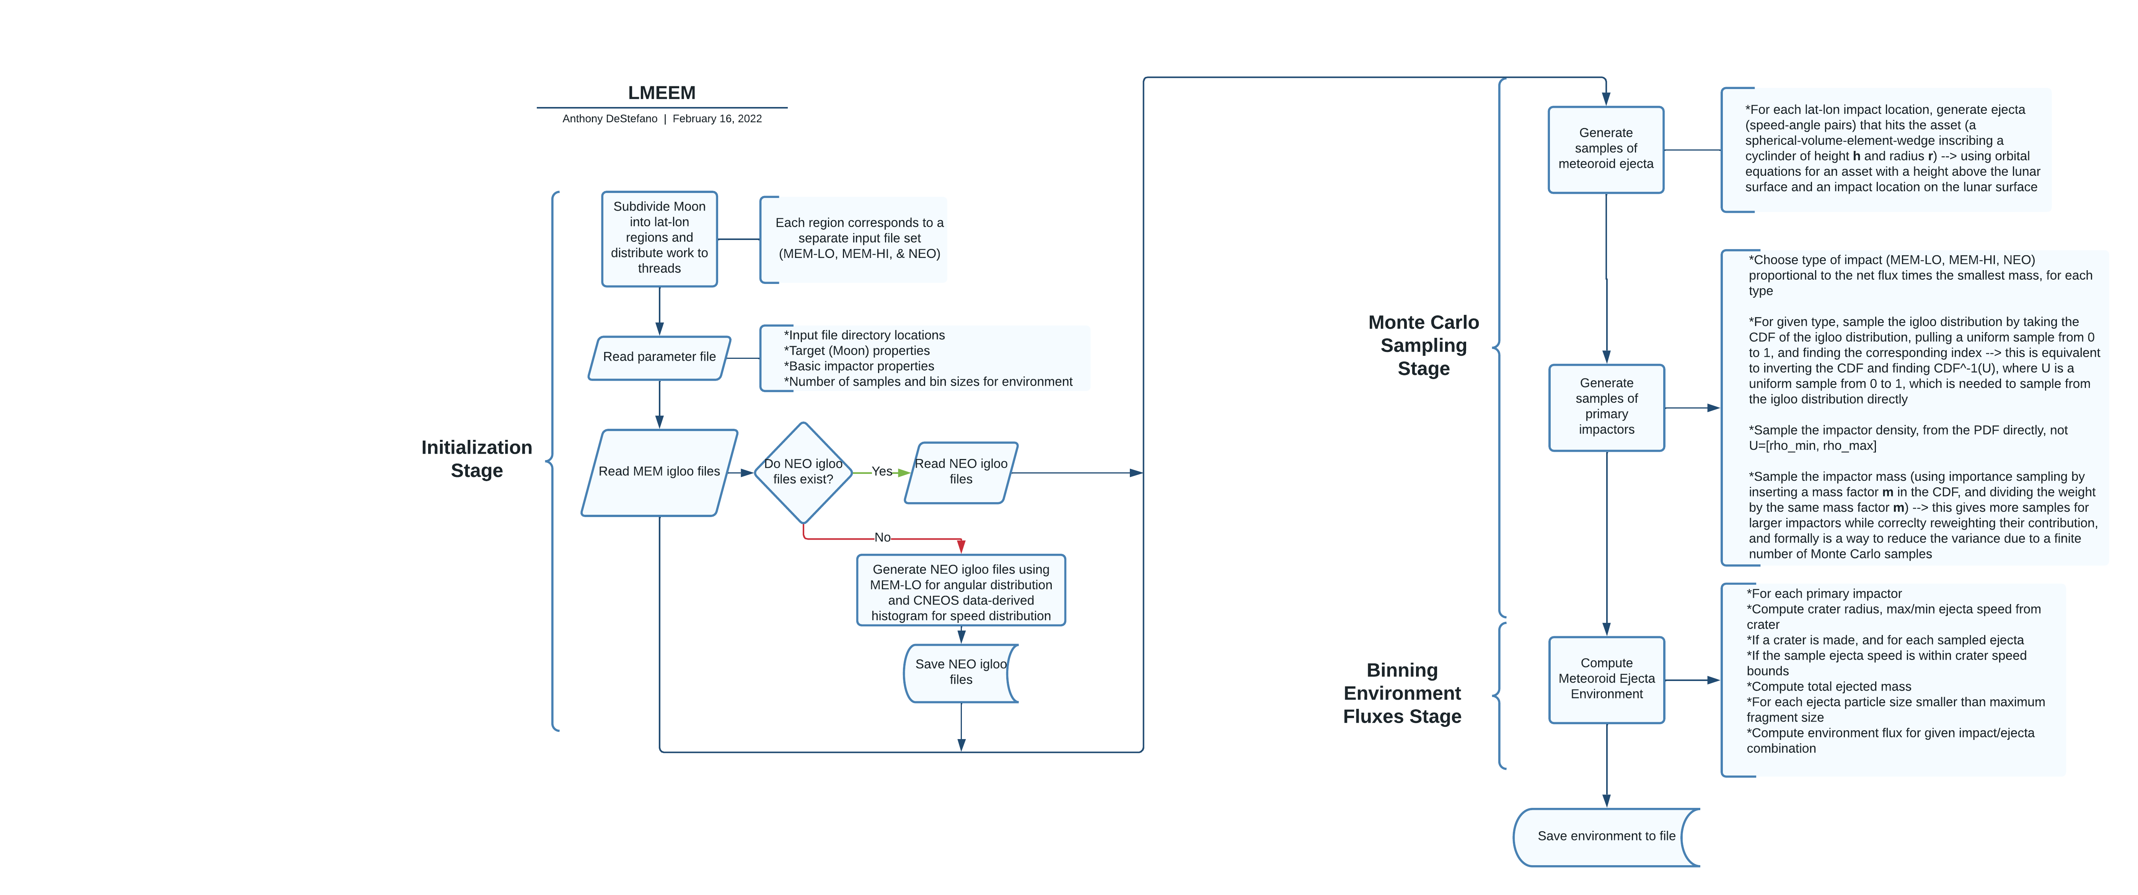

Slide 5
NESC Recommendations with EV44 actions
Recommendation # | NESC Recommendation | Action
R-1. | Use 1737.4 km for the geometrically averaged lunar radius. (O-1) | Incorporated
R-2. | Consider changing the model name and acronym to those that emphasize accuracy and ease of use (e.g., Lunar Ejecta Engineering Model (LEEM)). (O-2) | Proposed name: Lunar Meteoroid Ejecta Engineering Model (LMEEM)
R-3. | Use the terms "secondaries," "secondary environment," or "ejecta" in place of "secondary ejecta." (O-3) | Understood
R-4. | Calculate the meteoroid-to-NEO flux scaling using the meteoroid flux on a flat plate sitting on the lunar surface and facing local zenith as compared to the NEO flux onto the lunar surface per unit surface area. (F-2) | Incorporated
R-5. | Developer should work with experts from NASA's Meteoroid Environment Office to identify an appropriate mass boundary between the cometary and asteroidal populations. (F-3) | Forward work, near term

Slide 6
NESC Recommendations with EV44 actions
Recommendation # | NESC Recommendation | Action
R-6. | The NEO angular distribution should be corrected by extracting impact angles from an appropriate dynamical model of asteroids and comets.(F-4) | Forward work, far term
R-7. | The presence of ejecta detected at altitudes above the lunar surface suggests that it might be appropriate to consider extending MeMoSeE to also cover objects in low lunar orbit and provide an appropriate altitude limit where the model is applicable. (F-5) | Incorporated
R-8. | Include LADEE ejecta angular distributions inferred from plume measurements into the MeMoSeE model. (F-7) | Forward work, low priority
R-9. | Incorporate LADEE ejecta speed distributions into the MeMoSeE model and compare with current speed distribution assumptions. (F-8) | Forward work, low priority
R-10. | Incorporate jetted material expelled during the impact contact/compression phase into the MeMoSeE model. (F-10) | Forward work, far term

Slide 7
NESC Recommendations with EV44 actions
Recommendation # | NESC Recommendation | Action
R-11. | Consider modifying the MeMoSeE model to account for the clustering of secondary particles impacting the surface. (F-12) | Forward work, far term
R-12. | Use the Monte Carlo flux calculation results provided to verify MeMoSeE flux calculations. (F-13) | Finished, results agree with technical lead's findings
R-13. | Include ascending ejecta flux in the MeMoSeE model. (F-14, F-15) | Incorporated
R-14. | Include high-velocity (i.e., ? escape velocity) particle flux in the DSNE tables if ascending ejecta are added to the model. (F-16) | Incorporated
R-15. | Consider modifying the MeMoSeE model to use Monte Carlo methods in addition to or in lieu of analytic methods to compute the stochastic variability of the flux. (F-17) | Incorporated

Slide 8
NESC Recommendations with EV44 actions
Recommendation # | NESC Recommendation | Action
R-16. | The manner in which the flux results are tabulated and reported in the DSNE should be reconsidered, perhaps to include mean, median, and extreme cases (such as 95% confidence levels for maximum flux) suitable for incorporation into a Probabilistic Risk Assessment. (F-17) | In progress
R-17. | Reconsider choosing what is the "average" location/time on the Moon vs choosing several example locations for the DSNE (e.g., at different longitudes or use 7-day intervals rather than average 19 years). (F-18) | It was found that the western limb is the worst-case longitude, ~15% greater primary fluxes than the eastern limb. Time interval variation is forward work.
R-18. | Limit the maximum primary impactor size used to compute the ejecta or use a Monte Carlo technique to accurately incorporate large impactor effects. (F-19) | Incorporated
R-19. | Consider placing an upper limit on the ejected particle size determined from conservation of energy and/or the ejecta mass. (F-20) | In progress (based on O-Keefe & Ahrens 1985 and Koschny & Grun 2001)
R-20. | Developer should work with experts from NASA's Meteoroid Environment Office to reevaluate potential contributions from meteor showers to the ejecta environment. (F-21) | Forward work, far term

Slide 9
NESC Recommendations with EV44 actions
Recommendation # | NESC Recommendation | Action
R-21. | Perform a sensitivity study varying the soil size distribution parameters over the range of measured soil size distributions of the Apollo Program soil samples. (F-22, F-23) | Forward work, near term
R-22. | Use basalt as the target material for NEO impacts in the 1 m to 1 km diameter range. (F-24) | In progress
R-23. | In order for Bumper (and the DSNE) to use the MeMoSeE output, a preferred method of converting the MeMoSeE output to the number of ejecta particles per unit mass should be provided and documented in the algorithm document reference 21. (F-29) | In progress
R-24. | Correct the software issues identified in the Findings before the reviewed version can be used for DSNE updates. (F-27, F-28, F-30, F-31, F-32, F-33, F-34, F-35) | Major code changes have been made (help from ST13 personnel with code overview)
R-25. | Use the MEM 3 algorithm for averaging elevation angles. (F-36) | No longer have a set loop over impact angles, the angles are sampled using Monte Carlo

